Slide 1
TAK Server Deployment –Command Line
https://mytecknet.com/lets-build-a-tak-server/

Slide 2

TAK Server Deployment – Command Line
If you haven’t already, download TAK-SERVER
Go to the following link and download Rocky8 release version of TAK Server on your local machine to the “TAK Server Install” folder
https://tak.gov/products/tak-server

Slide 3
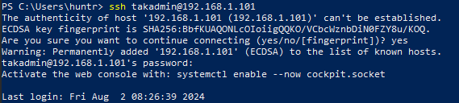
SSH into Virtual Machine
Open your choice of terminal (Default: PowerShell) or you can use PuTTY.
ssh into your VM by running the following command:
ssh <username>@<IP address>
You should be prompted asking if you are sure you want to connect, which you will respond “yes” and hit enter.
It will then ask you for your password.
Notes:
# They may not have been introduced to PuTTY so this may be a moment we need to talk more about it.

Slide 4
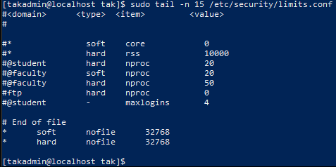
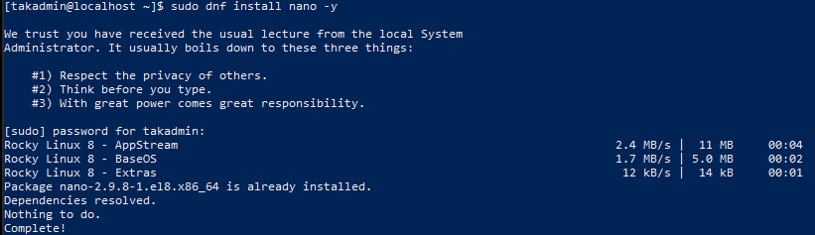
Prerequisites
Increase JVM threads
echo -e "* soft nofile 32768\n* hard nofile 32768\n" | sudo tee --append /etc/security/limits.conf
Each 'tab' is six spaces when typing manually
Tail to view the end contents of a file
sudo tail -n 15 /etc/security/limits.conf
Install nano or vim
sudo dnf install nano –y
sudo dnf install vim -y
Install packages for Enterprise Linux (EPEL)
Enable Powertools
sudo dnf config-manager --set-enabled powertools
Rocky Linux 9
sudo dnf config-manager --set-enabled crb
Install EPEL Rocky linux 8
sudo dnf install epel-release -y
Notes:
# With a fresh OS we need to modify the Linux pluggable authentication module limits set within the /etc/security/limits.conf file Specifically we need to increase the number of file handles allowed within the per-suer limit for the open files to support Java threads.
# Running the scripts allows us to configure the soft (user override) and hard (root override) limits.
# We also need to install "nano" which is a text editor for Unix.
# Next, we need to install extra packages for Enterprise Linux (EPEL) to provide the extra repositories required for then next installations.

Slide 5
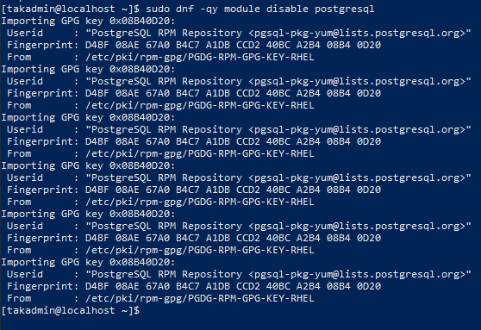
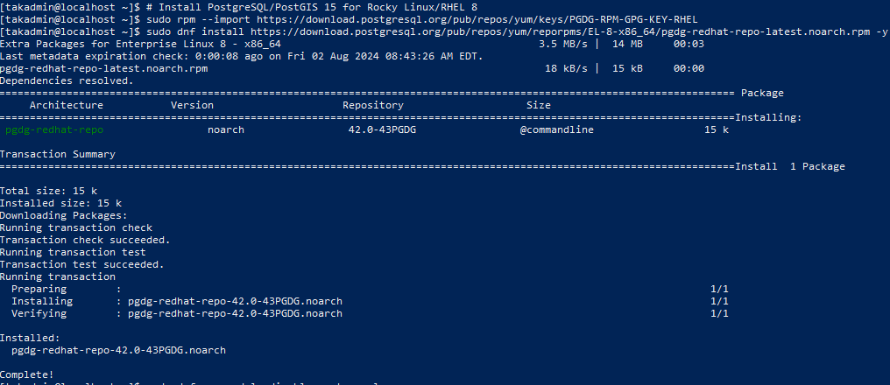
Prerequisites
Install PostgreSQL/PostGIS 15
sudo rpm --import https://download.postgresql.org/pub/repos/yum/keys/PGDG-RPM-GPG-KEY-RHEL
sudo dnf install https://download.postgresql.org/pub/repos/yum/reporpms/EL-8-x86_64/pgdg-redhat-repo-latest.noarch.rpm -y
sudo dnf -qy module disable postgresql
Notes:
# PostgreSQL: a free open source relational database manager system. It has relational capabilities and an object-oriented design. It allows programmers to communicate with the database servers using objects in their code.
# PostGIS is an extension for PostgreSQL that allows GIS (geographic information systems) objects to be stored in the database.

Slide 6
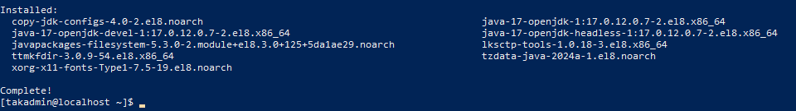
Prerequisites
Update Rocky Linux
sudo dnf update -y
Install Java OpenJDK
sudo dnf install java-17-openjdk-devel -y
Notes:
# Java OpenJDK: open-source implementation of the Java platform

Slide 7
Installation Instructions
Copy files from host machine to your VM
Open another terminal in the specific folder that holds the TAK Server download.
Navigate to the file with File Explorer.
At the top of File Explorer select “File” -> “open with PowerShell”
scp takserver-5.*.rpm <username>@<IP address>:~/
If needed, you can specify the entire name of the file instead of using “.*.”
scp takserver-5.2-RELEASE16.noarch.rpm <username>@<IP address>:~/
You will be prompted for the password and the file transfer will start.
Notes:
# We need to transfer the server installation file over to the Linux machine from our local host.
# If you have multiple versions of TAK Server downloaded it will copy over all the ones unless the entire name is inputted.

Slide 8
Installation Instructions
In our ssh session window to the VM you should be able to now see the file we transferred by running:
ls
Install the TAK Server file we just transferred.
sudo dnf install takserver-5.*.rpm -y
If you need to specify the server's name you can, but since we only have one file named this, we can use the abbreviation.
If needed, enter your password and the download should begin.

Slide 9
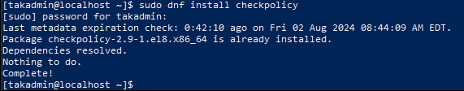

Installation Instructions
Check SELinux status (Security-Enhanced Linux)
getenforce
If SELinux is enforcing, we need to apply the SELinux profile for the TAK Server by installing an extra package before applying the SELinux profile.
Install checkpolicy
sudo dnf install checkpolicy
enter your password if needed
Apply the TAK Server SELinux profile
cd /opt/tak && sudo ./apply-selinux.sh
Notes:
# SELinux stands for Security-Ehanced Linux and is a security feature developed initially by the National Security Agency that provides a technical control for supporting access security and mandatory access controls.
# checkpolicy: program that checks and compiles a SELinux security poly configuration into a binary representation that can be loaded into the kernel.

Slide 10
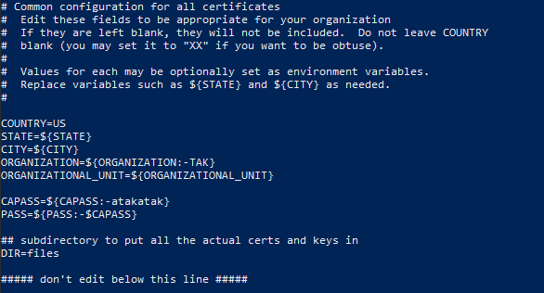
Initial Configuration
Switch to the “tak” user
sudo su tak
Change the directory
cd /opt/tak/certs
Open the file
vi cert-metadata.sh
To edit the file press “i”
Change the following fields: (additional instructions are at the top)
COUNTRY=<enter country>
STATE=<enter state>
CITY=<enter city>
ORGANIZATION=<enter org>
ORGANIZATION UNIT=<enter org unit>
Optionally you can modify the password for the cert located at “atakatak” leaving the “-” before it
To exit:
Press the “esc” key
Type the following: :wq!
Notes:
# This section will establish our root and intermediate certificate authority (CA), the server certificate, and an admin client certificate.
# The sequence and execution of this task is important in the PKI (Public Key Infrastructure) environment as it establishes a chain of trust.
# We will need to edit the contents within the cert-metadata.sh file to create the certificate information for our environment by setting the country, state, city, organization, and organization unit. You are also able to modify the default certificate password here.
# :wq! wirtes the changes to the file and then quits.
# When using spaces for values the values must be surrounded by quotes: STATE="New York“
# if you change the password it needs to be at least 6 characters long

Slide 11
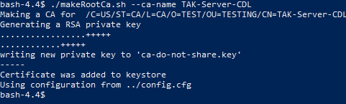
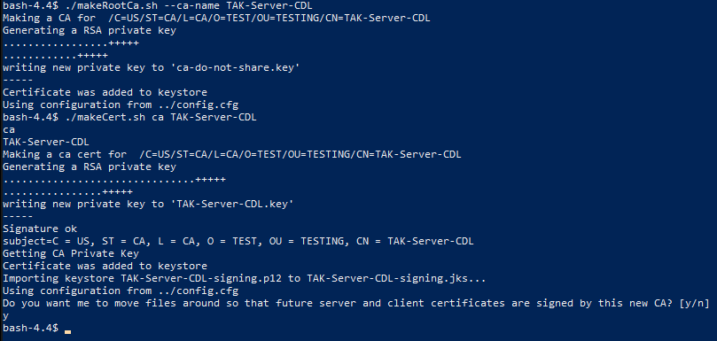
Initial Configuration
Creating the Root Certificate Authority
./makeRootCa.sh or ./makeRootCa.sh --ca-name <CommonName>
Example: ./makeRootCa.sh --ca-name TAK-ROOT-CA-01
Creating the Intermediate Certificate Authority
./makeCert.sh ca or ./makeCert.sh ca <CommonName>
Example: ./makeCert.sh ca TAK-ID-CA-01
Once you hit enter it’ll come to a point where it’ll ask you: “Do you want me to move files around”
type: y
hit enter
Notes:
# You can use the second method to create the root ca to immediately give it a name of the first and it will ask you for a name
# Remove a file: rm <fileName>
# The intermediate CA will act on behalf of the root CA and will sign/issue certificates to our client. We make it our signing and issuing authority with the "ca" tag

Slide 12
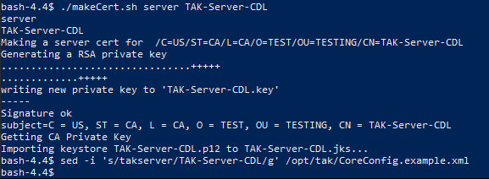
Initial Configuration
Creating the Server Certificate
./makeCert.sh server takserver
By default, the name is takserver, if you wish to use a different name, we will need to update our files.
sed -i 's/takserver/<TAKServerName>/g' /opt/tak/CoreConfig.example.xml
Notes:
# This public certificate will be what our clients validate against when connecting. We will use the makeCert.sh script that includes both the client and server authentication in the extended key properties.
# The CoreConfig.example.xml file contains the baseline configuration for the TAK Server. Once we restart the CoreConfig.example.xml file will create the CoreConfig.xml file. Which is the active configuration that the server references for all operations.

Slide 13
Initial Configuration
Modifying the Core Configuration
Modify the default truststore-root with out new truststore-<CommonName>
sed -i 's/truststore-root/truststore-<CACommonName>/g' /opt/tak/CoreConfig.example.xml
Example: sed -i 's/truststore-root/truststore-TAK-ID-CA-01/g' /opt/tak/CoreConfig.example.xml
You can verify the changes by running to following command:
cat /opt/tak/CoreConfig.example.xml | grep truststore-
If you changed the password for the certificates, you would also need to update that within the CoreConfig.example.xml file.
sed -i ‘s/atakatak/<password>/g’ /opt/tak/CoreConfig.example.xml
Notes:
# So far we have created our root and intermediate CA, along with our server certificate.
# Now we need to modify the CoreConfig.example.xml file which contains the baseline configuration for out TAK Server. Once the server starts this file will create the CoreConfig.xml file that will be that active configuration for the server.
# In the file we will need to change the default value stored for the CA to our newly created intermediate CA. This allows the server to start successfully since the TAK Server is essentially a client of itself. So it needs to trust who signed it, along with needing to trust the clients it issues certs to via the trusted CA chain. This is known as our client keystore and then we have our server truststore.

Slide 14
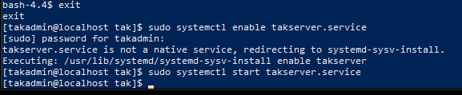
Initial Configuration - Starting the TAK Server
Exit out of the tak user session
exit
Enable the takserver.service, allowing it to start at system startup
sudo systemctl enable takserver.service
Start the TAK Server service
sudo systemctl start takserver.service

Slide 15
Initial Configuration - Starting the TAK Server
Verify the server is running:
Monitor the /opt/tak/logs/ directory for the takserver-messaging.log
ls -l /opt/tak/logs/
make sure the takserer-messaging.log file was created.
Tail a streaming output of the end of the log
tail -f /opt/tak/logs/takserver-messaging.log
INFO c.b.marti.nio.netty.NioNettyBuilder - Successfully Started Netty Server for TlsServerInitializer on Port 8089 with watermark WriteBufferWaterMark(low: 2048, high: 4096)
This lets us know that the client-to-server listener is started and is accepting clients
INFO com.bbn.marti.nio.server.NioServer - Server started
This tells us the services have started
INFO com.bbn.marti.util.VersionBean - TAK Server version 5.0-RELEASE-29-HEAD
This lets me know what version is running and that all services have started

Slide 16
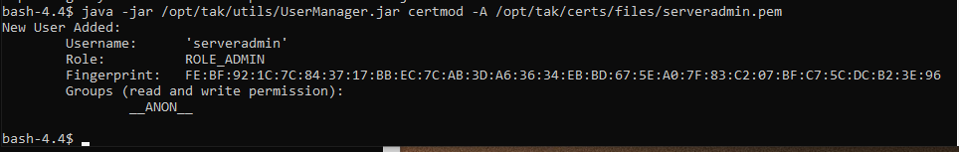
Initial Configuration - Creating the Admin Certificate
Switch to the “tak” user
sudo su tak
Change the directory to certs
cd /opt/tak/certs
Make the Admin Certificate
./makeCert.sh client <CommonName>
Example: ./makeCert.sh client webadmin
Modify the certificate to provide admin access
java -jar /opt/tak/utils/UserManager.jar certmod -A /opt/tak/certs/files/<commonName>.pem
Example: java -jar /opt/tak/utils/UserManager.jar certmod -A /opt/tak/certs/files/webadmin.pem

Slide 17
Initial Configuration
Exit the tak user session
exit
Change the directory to the Linux home directory
cd ~
Copy the admin cert to our home directory
sudo cp -v /opt/tak/certs/files/webadmin.p12 .
Copy the truststore cert to our home directory
sudo cp -v /opt/tak/certs/files/truststore-TAK-ID-CA-01.p12 .
Change the ownership to our Linux user
sudo chown -R <username>:<usergroup> /home/<username>
Example: sudo chown -R takadmin:takadmin /home/takadmin
If you don’t do this, you can’t copy the files from the server to your development machine.
You can us “ls” to verify that the file is in the right place .
Notes:
# Now that we have created the admin cert we need to move it so that we can copy and install it on our admin workstation remotely.
# Remember to add the period at the end of the command when moving the cert to move it to the current location

Slide 18
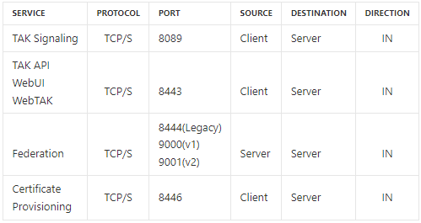
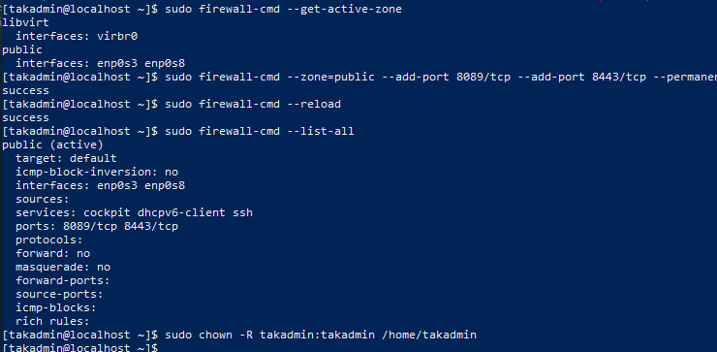
Configuring the Firewall
Determine the active firewall
sudo firewall-cmd --get-active-zones
the default is public in most installations
Modify the zone to allow secure client-to-server communications
sudo firewall-cmd --zone=public --add-port 8089/tcp --add-port 8443/tcp --add-port 8446/tcp --permanent
Reload the firewall to apply changes
sudo firewall-cmd --reload
Verify the changes to the firewall
sudo firewall-cmd --list-all
Notes:
# To accept connections to our TAK Server we need to modify the firewall. We want to ensure we accept secure connections over TLS (Transport Layer Security) by our PKI environment.
# TCP/s = TLS/SSL TCP TCP: Transmission Control Protocol = enables application programs and computing devices to exchange messages over a network. TLS: Transport Layer Security = facilitates privacy and data security for communications over the internet. SSL: Secure Sockets Layer = secures internet connection by encrypting data sent between a website and a browser.

Slide 19
The Administrative Dashboard - Downloading the Admin Cert
Copy admin file from our Linux server to our local machine.
From our local machine open File Explorer to the location, you would like the admin cert file to download to.
Once there open the command line to this file:
In File Explorer in the top left of the screen selection File -> Open in PowerShell
In Powershell type the following:
scp <username>@<IP address>:~/<CommonName>.p12 .
Example: scp takadmin@192.168.1.104:~/webadmin.p12 .
Don’t forget the period at the end to designate the current location to be where the file is downloaded to.
Enter the user password when asked for it.
Notes:
# By this point we have installed our pre-requirements, installed our TAK Server, created our PKI (Public Key Infrastructure) environment, established an admin certificate, and modified our firewall to accept client connections.
# To access the TAK Server admin dashboard (Marti) we need to copy over our admin cert from the server to our workstation.
# If you did not change the user settings for the file to the current user then you will be denied from downloading the file. See slide 16 to fix this.

Slide 20
Importing User Certificate
Windows:
Double click on the user certificate, which will open the windows certificate import wizard.
Store Location: Current User
File path should be correct
Password: atakatak
Certificate Store: Automatically select the certificate store based on the type of certificate
Select “Finish”
Select “Yes” for the security warning
Import should be successful

Slide 21
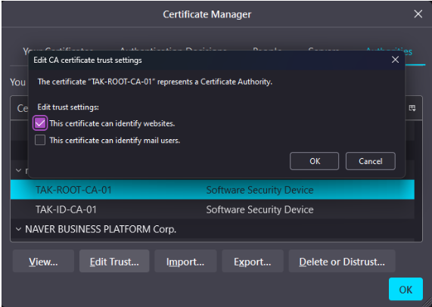
The Administrative Dashboard - Firefox
Open Firefox settings and search for “cert” to find the “view certificates” option.
In the certificate manager panel, you want to make sure you select the “Your Certificates” tab and select import.
Navigate to where you stored the certificate file and select it.
If you are at the folder location for the certificate and can't, see it, change the filtering settings in the bottom right of the File Explorer.
It should ask you for the certificate password, if you did not change it the password is: atakatak
Once imported select the “Authorities” tab in the “Certificate Manager” panel.
Scroll down to find your certificates.
Note it will be under the name you gave for the “ORGANIZATION” you entered.
Once you found both the certificates one at a time select them and select the “Edit Trust…” button towards the bottom of the panel.
Enable the “This certificate can identify websites” option for both.

Slide 22
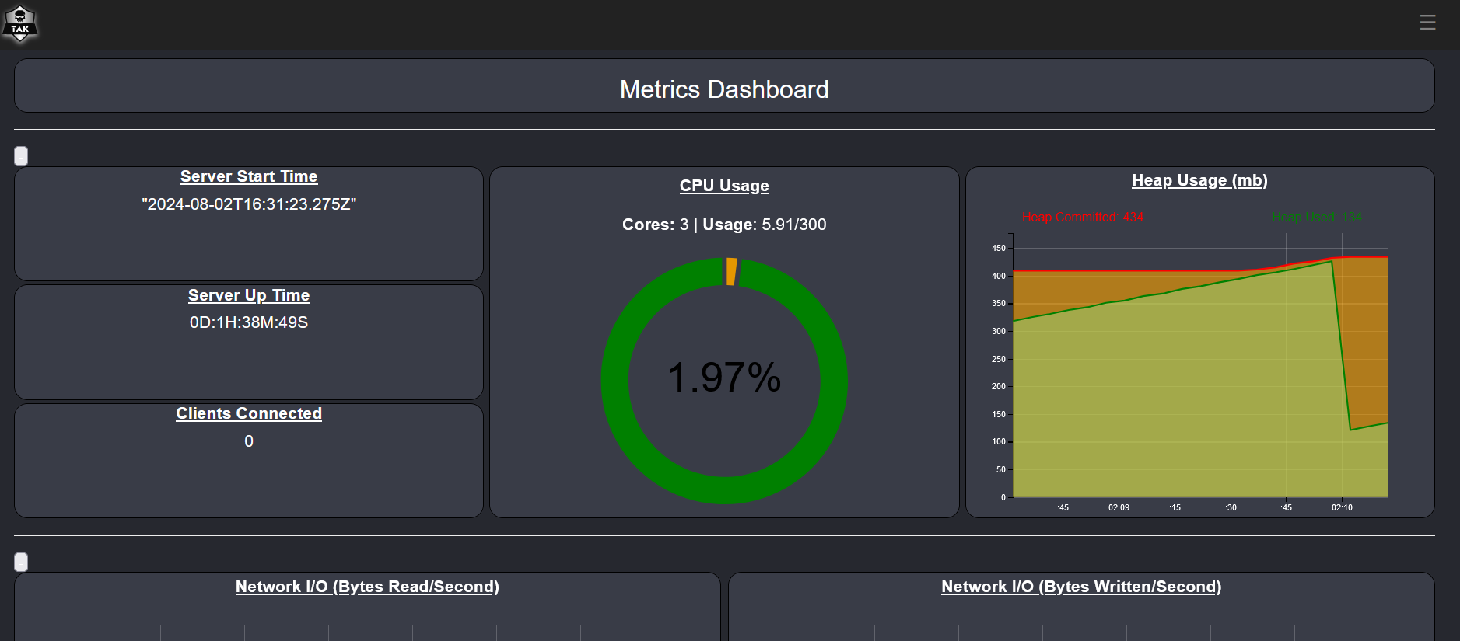
The Administrative Dashboard
You can close out of the “Certificate Manager” and open a new tab.
In the new tab type in the following link:
https://<IP address>:8443
A warning risk will pop up, which you will scroll down and select “Accept the Risk and Continue”
If done right, you should now see the server dashboard.

